Slide 1
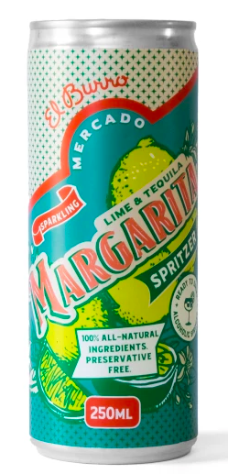
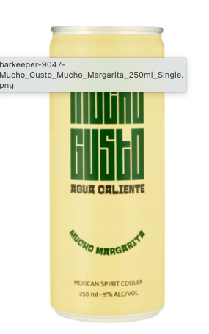
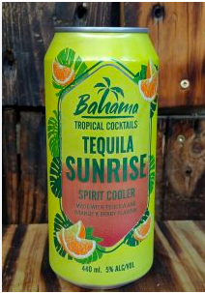
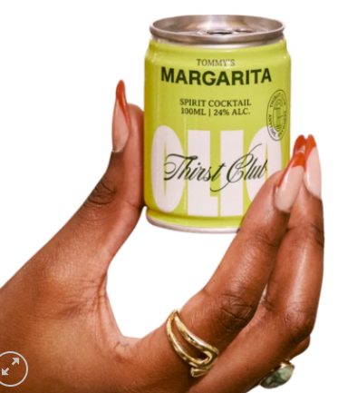
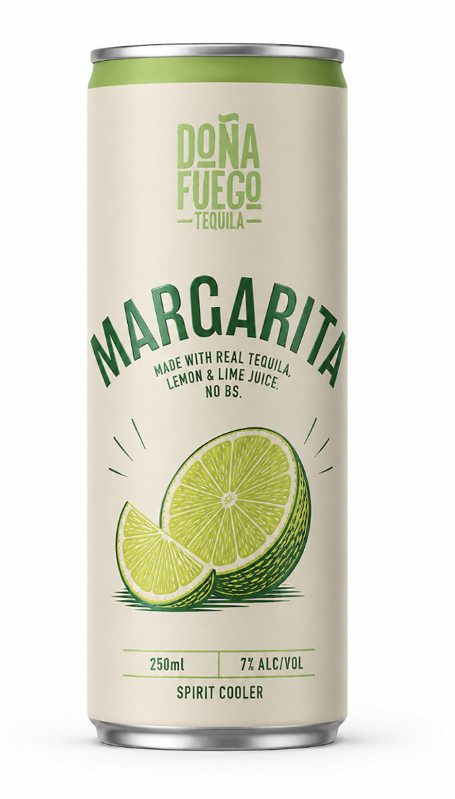
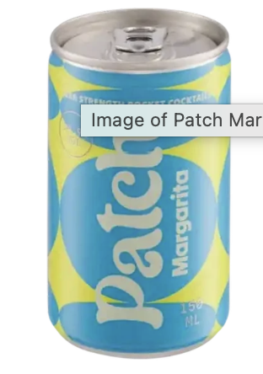
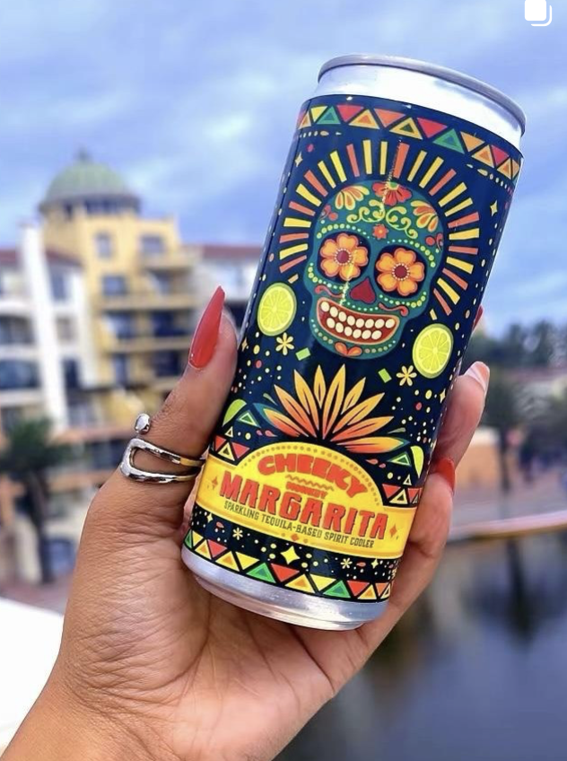
Brand | Tequila | size | %ALC | Checkers | PnP | Yuppie Chef | Online | Bar keeper | Spar
Doña Fuego RTD | Import (DF) | 250ML | 7 | Exclusive (R169 4P/ R49 unit)
Mercado Margarita Spritzer | import | 250ML | 5 | R39.99 |  | R45.00
Mucho Gusto | local agave | 250ML | 5 |  | R42.00 |  |  | R39.00
Bahama spirit cooler | tequila flavour | 440ML |  |  |  |  | R22.00
Olie margarita | tequila | 100ML | 24 |  |  |  |  | R89.00
Patch | Import (DF) | 150ML | 14.9 | Exclusive (R159 4P/ R49 Single)
Cheeky | Import (DF) | 300ML | 4.5 |  |  |  |  |  | Exclusive (R210 4P/ R55 Single)

